Slide 1
WD5 & WD4 Structure

Slide 2
Template Sequences
WD5 – [W.D.W.D.W.D.W.D.W.D.]
28.9% live – 107,973 sequences
WD4 – [W..D..W..D..W..D..W..D]
14.2% live – 19,476 sequences

Slide 3
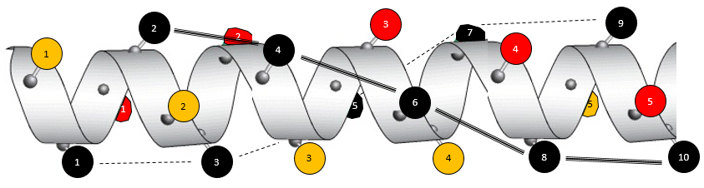
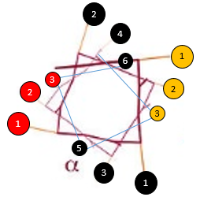
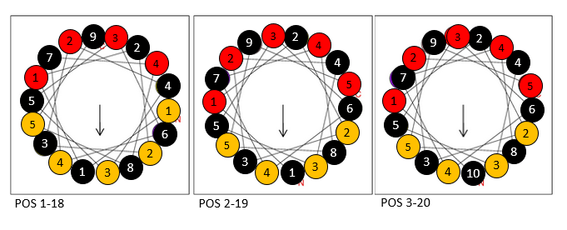
WD5 – wrapped around α-helix [W.₁D.₂W.₃D.₄W.₅D.₆W.₇D.₈W.₉D.₁₀]
A
A: full tAD sequence wrapped around α-helix.
B: top-down look through α-helix. Nicely highlights the bands that form in figure A.
C: Shows embedding of random aa positions in either aromatic or acidic face of α-helix.
Can this view explain saw-tooth nature of aa_position vs live_percent plot?
B
C

Slide 4
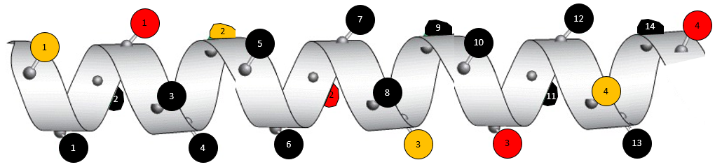
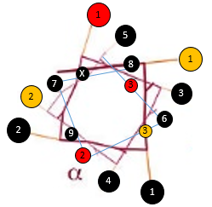
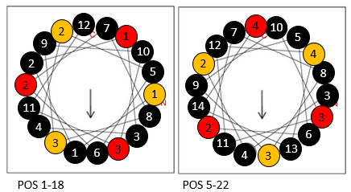
WD4 – wrapped around α-helix [W.₁.₂D.₃.₄W.₅.₆D.₇.₈W.₉.₁₀D.₁₁.₁₂W.₁₃.₁₄D]
A
A: full tAD sequence wrapped around α-helix.
B: top-down look through α-helix.
C: Shows faces of α-helix. In the case of WD4 template, it does not form amphipathic helix.
B
C

Slide 5
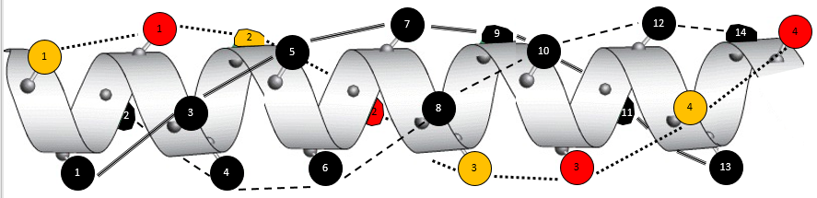
Comparing WD5 and WD4 helices
WD5 forms 4 clock-wise spirals: 2 aliphatic spirals, 1 acidic, and 1 aromatic
---------------------------------------------------------------------------------------------------------
WD4 forms 3 counter clock-wise spirals: 2 aliphatic and 1 aromatic-acidic
WD4 forms 4 clock-wise spirals: 2 aromatic-aliphatic, 2 acidic-aliphatic

